Slide 1

DGS General Coding Guideline

Slide 2
Agenda 5.1 Style Guide
5.1.1 Standard File Header Information
5.1.2 General style guide rules
5.1.3 Comment in (C−) source code
5.1.4 Block layout
2
RBVH/EJV3 | 2018-05-28
© Robert Bosch Engineering and Business Solutions Vietnam Company Limited 2018. All rights reserved, also regarding any disposal, exploitation, reproduction, editing, distribution, as well as in the event of applications for industrial property rights.

Slide 3
5.1.1 Standard File Header Information
5.1 Style Guide
eASEE File Header
What?
Every source file (*.c−file, *.h−file, *_pavast.xml−file, *_confdata.xml−file) which is delivered to eASEE/SDOM shall be headed by the standard eASEE/SDOM file header.
Why?
System header files declare the interfaces to parts of the operating system. You include them in your program to supply the definitions and declarations you need to invoke system calls and libraries.
Your own header files contain declarations for interfaces between the source files of your program. Each time you have a group of related declarations and macro definitions all or most of which are needed in several different source files, it is a good idea to create a header file for them.
3
RBVH/EJV3 | 2018-05-28
© Robert Bosch Engineering and Business Solutions Vietnam Company Limited 2018. All rights reserved, also regarding any disposal, exploitation, reproduction, editing, distribution, as well as in the event of applications for industrial property rights.

Slide 4
5.1.1 Standard File Header Information
5.1 Style Guide
eASEE File Header
Template files:
CONFDATA : RBHeader_Handcode / 1.0.0; 0
SWHDR : RBHeader_Handcode / 1.0.0; 0
SWSRC : RBHeader_Handcode / 1.0.0; 0
TDATA : RBHeader_Handcode / 1.0.0; 0
4
RBVH/EJV3 | 2018-05-28
© Robert Bosch Engineering and Business Solutions Vietnam Company Limited 2018. All rights reserved, also regarding any disposal, exploitation, reproduction, editing, distribution, as well as in the event of applications for industrial property rights.

Slide 5
5.1.1 Standard File Header Information
5.1 Style Guide
Users have to follow below steps:
1. Search for the above files via eASEE−SDOM search feature.
2. Invoke 'Checkout without reservation', 'Replace Keywords' unchecked.
3. Rename the files on the checkout directory as per project/component name.
5
RBVH/EJV3 | 2018-05-28
© Robert Bosch Engineering and Business Solutions Vietnam Company Limited 2018. All rights reserved, also regarding any disposal, exploitation, reproduction, editing, distribution, as well as in the event of applications for industrial property rights.

Slide 6
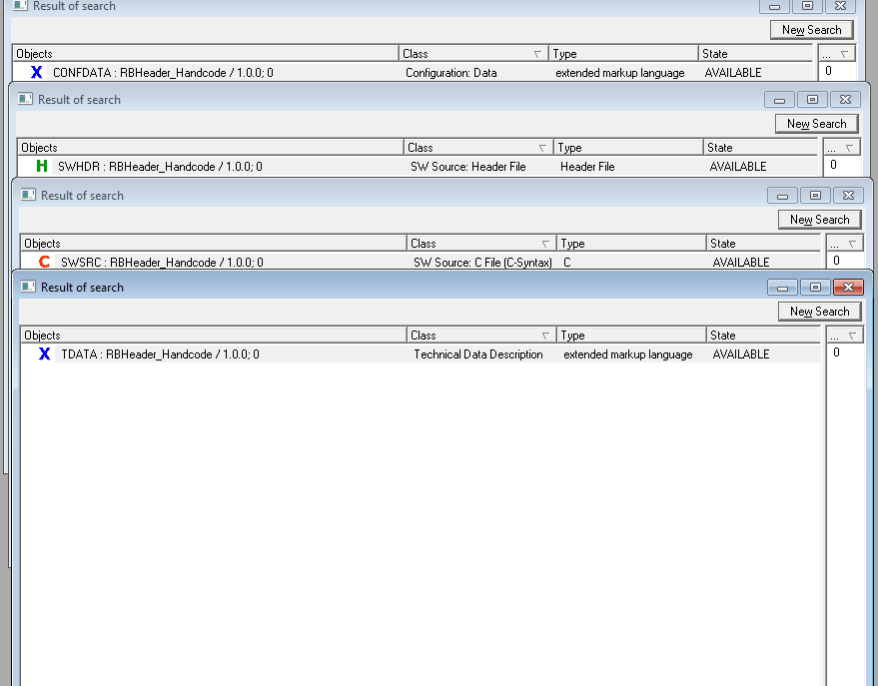
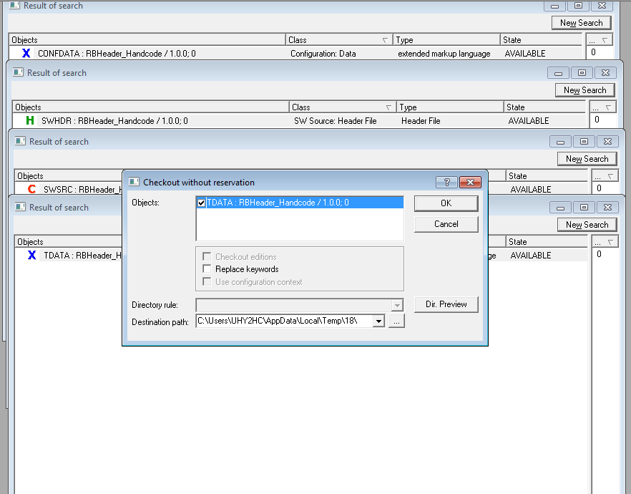
5.1.1 Standard File Header Information
5.1 Style Guide
6
RBVH/EJV3 | 2018-05-28
© Robert Bosch Engineering and Business Solutions Vietnam Company Limited 2018. All rights reserved, also regarding any disposal, exploitation, reproduction, editing, distribution, as well as in the event of applications for industrial property rights.

Slide 7
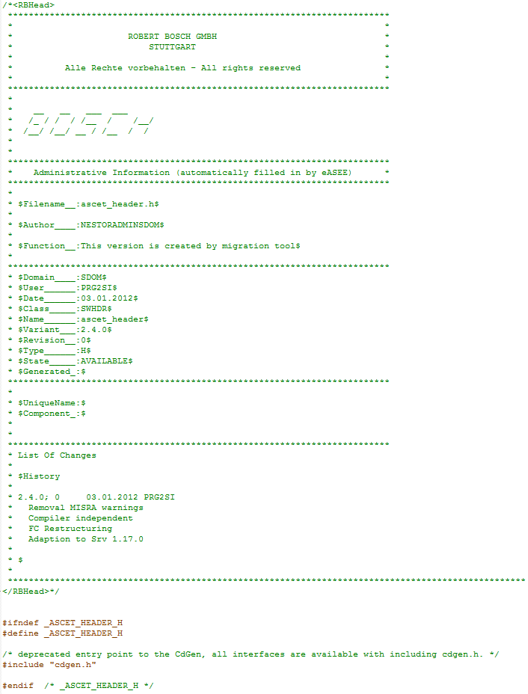
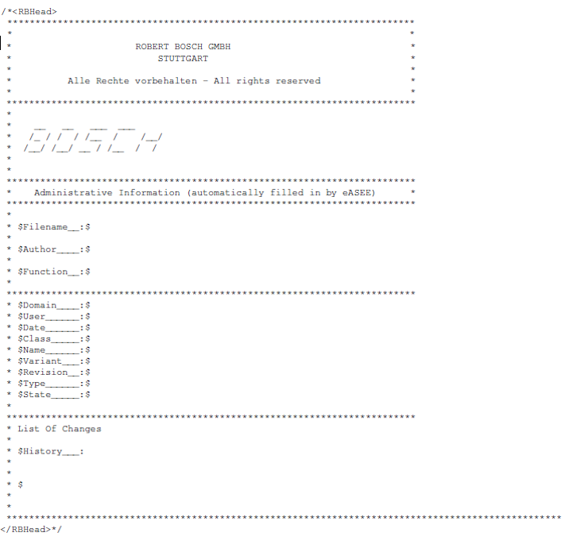
5.1.1 Standard File Header Information
5.1 Style Guide
7
RBVH/EJV3 | 2018-05-28
© Robert Bosch Engineering and Business Solutions Vietnam Company Limited 2018. All rights reserved, also regarding any disposal, exploitation, reproduction, editing, distribution, as well as in the event of applications for industrial property rights.

Slide 8
5.1.2 General style guide rules
5.1 Style Guide
The line length shall not exceed 120 characters (including whitespace)
Each new instruction block shall be indented by 4 whitespaces (2 whitespaces for ASCET−generated C−Code).
The "Tab" character (ASCII code 09) is not permitted in the code. The editor in the development environment shall be set in such a way that a tabulator is replaced by 4 whitespaces.
DOS EOL <CR><LF> ( \r \n, DOS/windows style) is used as end of line character. The editor shall be adjusted accordingly. <CR> (\r, DOS keyboard shortcut control−M) is not C90 konform and therefore not allowed. <LF> (\n) is not allowed in UBK.
\r (Carriage Return) - moves the cursor to the beginning of the line without advancing to the next line
\n (Line Feed) - moves the cursor down to the next line without returning to the beginning of the line - In a *nix environment \n moves to the beginning of the line.
\r\n (End Of Line) - a combination of \r and \n
UBK: Germ., Unternehmensbereich Kraftfahrzeugtechnik (Automotive Technology Business Sector)
8
RBVH/EJV3 | 2018-05-28
© Robert Bosch Engineering and Business Solutions Vietnam Company Limited 2018. All rights reserved, also regarding any disposal, exploitation, reproduction, editing, distribution, as well as in the event of applications for industrial property rights.

Slide 9
5.1.2 General style guide rules
5.1 Style Guide
Names of customers shall not appear in the source code.
Long statements should be split up over several lines so that a maximum readability is ensured.
Mathematical operators shall be embedded in whitespaces. This rule does not apply to brackets.
Example:
result_u16 = (a_u8 * b_u8) + c_u16;
Only one variable definition per line, no comma separated definition.
Not: Allowed:
uint16 a_u16, c_u16; uint16 a_u16;
uint16 c_u16;
9
RBVH/EJV3 | 2018-05-28
© Robert Bosch Engineering and Business Solutions Vietnam Company Limited 2018. All rights reserved, also regarding any disposal, exploitation, reproduction, editing, distribution, as well as in the event of applications for industrial property rights.

Slide 10
5 General C−Coding Rules
DGS General Coding Guideline
References:
1. Compliance to Specification
2. Compliance to External and Internal Standards
3. OSS free
4. Maintainability
5. Modularisation
6. Readability
7. Real−Time Ability
8. Integrability
9. Compiler Independence
10. ECU−ResourceSaving
11. Test what is delivered
10
RBVH/EJV3 | 2018-05-28
© Robert Bosch Engineering and Business Solutions Vietnam Company Limited 2018. All rights reserved, also regarding any disposal, exploitation, reproduction, editing, distribution, as well as in the event of applications for industrial property rights.

Slide 11
5.1.3 Comments in (C−) source code
5.1 Style Guide
What is it ?
In the C Programming Language, you can place comments in your source code that are not executed as part of the program.
Why comments ?
Comments provide clarity to the C source code allowing others to better understand what the code was intended to accomplish and greatly helping in debugging the code. Comments are especially important in large projects containing hundreds or thousands of lines of source code or in projects in which many contributors are working on the source code, ( Maintain and readability)
11
RBVH/EJV3 | 2018-05-28
© Robert Bosch Engineering and Business Solutions Vietnam Company Limited 2018. All rights reserved, also regarding any disposal, exploitation, reproduction, editing, distribution, as well as in the event of applications for industrial property rights.

Slide 12



5.1.3 Comments in (C−) source code
5.1 Style Guide
Rule and Example
Following comment marks are allowed. /*….*/ and //
or
Code sections that are not self−explanatory shall be extended by a meaningful comment.
12
RBVH/EJV3 | 2018-05-28
© Robert Bosch Engineering and Business Solutions Vietnam Company Limited 2018. All rights reserved, also regarding any disposal, exploitation, reproduction, editing, distribution, as well as in the event of applications for industrial property rights.

Slide 13
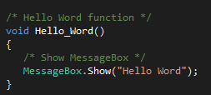
5.1.3 Comments in (C−) source code
5.1 Style Guide
3. Comments in the source code shall be written in English
4. Comments are essential for workaround and rule violations.
5. The content of a comment should be limited to a minimum.
6. The comment is aligned at the code to which it belongs. The orientation of the alignment is related to the comment mark.
13
RBVH/EJV3 | 2018-05-28
© Robert Bosch Engineering and Business Solutions Vietnam Company Limited 2018. All rights reserved, also regarding any disposal, exploitation, reproduction, editing, distribution, as well as in the event of applications for industrial property rights.

Slide 14
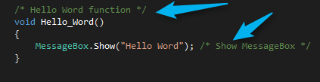

5.1.3 Comments in (C−) source code
5.1 Style Guide
7. A comment behind code is allowed too. It is prohibited to write code behind a comment.
Accepted
Not Accepted
14
RBVH/EJV3 | 2018-05-28
© Robert Bosch Engineering and Business Solutions Vietnam Company Limited 2018. All rights reserved, also regarding any disposal, exploitation, reproduction, editing, distribution, as well as in the event of applications for industrial property rights.

Slide 15

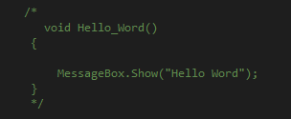
5.1.3 Comments in (C−) source code
5.1 Style Guide
8. Nesting of comments is not allowed. Tools might handle nested comments in a different way.
9. Code shall under no circumstances be commented out (especially upon a delivery). This can especially cause errors when using the nested structure /* ... */
15
RBVH/EJV3 | 2018-05-28
© Robert Bosch Engineering and Business Solutions Vietnam Company Limited 2018. All rights reserved, also regarding any disposal, exploitation, reproduction, editing, distribution, as well as in the event of applications for industrial property rights.

Slide 16
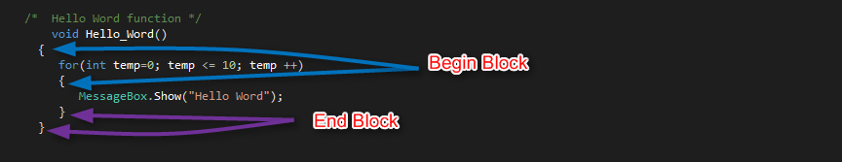
5.1.4 Block layout
5.1 Style Guide
What is it ?
- Using for loop, if−else, do−while, while, switch−case:
-Rule and Example
The begin of a block "{" shall start at a new line and shall be the only character in this line.
16
RBVH/EJV3 | 2018-05-28
© Robert Bosch Engineering and Business Solutions Vietnam Company Limited 2018. All rights reserved, also regarding any disposal, exploitation, reproduction, editing, distribution, as well as in the event of applications for industrial property rights.

Slide 17
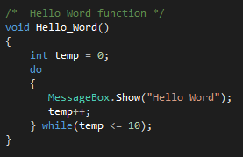
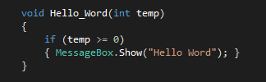
5.1.4 Block layout
5.1 Style Guide
This is also true for the end of a block "}".(Except the character indicates the end of a structure definition or is followed by a while command.)
If an instruction block only contains one instruction, the block shall nevertheless be marked by "{" and "}".
17
RBVH/EJV3 | 2018-05-28
© Robert Bosch Engineering and Business Solutions Vietnam Company Limited 2018. All rights reserved, also regarding any disposal, exploitation, reproduction, editing, distribution, as well as in the event of applications for industrial property rights.

Slide 18
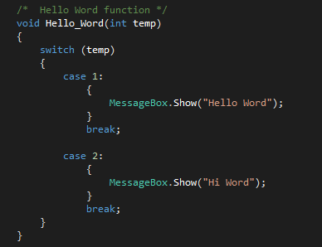
5.1.4 Block layout
5.1 Style Guide
After a block a new line should be entered.
18
RBVH/EJV3 | 2018-05-28
© Robert Bosch Engineering and Business Solutions Vietnam Company Limited 2018. All rights reserved, also regarding any disposal, exploitation, reproduction, editing, distribution, as well as in the event of applications for industrial property rights.

Slide 19
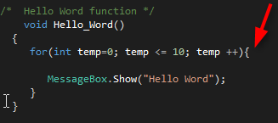

5.1.4 Block layout
5.1 Style Guide
Bad case
19
RBVH/EJV3 | 2018-05-28
© Robert Bosch Engineering and Business Solutions Vietnam Company Limited 2018. All rights reserved, also regarding any disposal, exploitation, reproduction, editing, distribution, as well as in the event of applications for industrial property rights.

Slide 20
Q&A Section
20
RBVH/EJV3 | 2018-05-28
© Robert Bosch Engineering and Business Solutions Vietnam Company Limited 2018. All rights reserved, also regarding any disposal, exploitation, reproduction, editing, distribution, as well as in the event of applications for industrial property rights.

Slide 21
Thank you for listening!
21
RBVH/EJV3 | 2018-05-28
© Robert Bosch Engineering and Business Solutions Vietnam Company Limited 2018. All rights reserved, also regarding any disposal, exploitation, reproduction, editing, distribution, as well as in the event of applications for industrial property rights.

